Slide 1
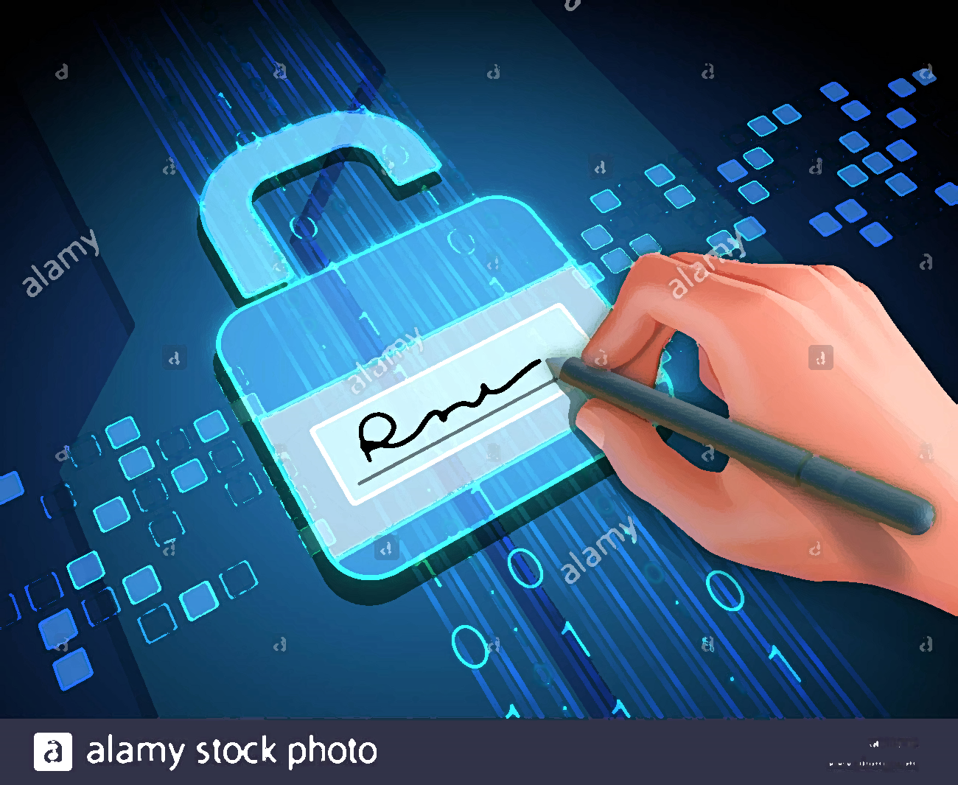
Digital Signature

Slide 2
It is an electronic signature that can be used to authenticate the identity of the sender of a message or the signer of a document, and possibly to ensure that the original content of the message or document that has been sent is unchanged. Digital signatures are easily transportable, cannot be imitated by someone else, and can be automatically time-stamped. The ability to ensure that the original signed message arrived means that the sender cannot easily repudiate it later.

Slide 3
Digital signature serves three purposes:
Authentication
Integrity
Non repudiation

Slide 4
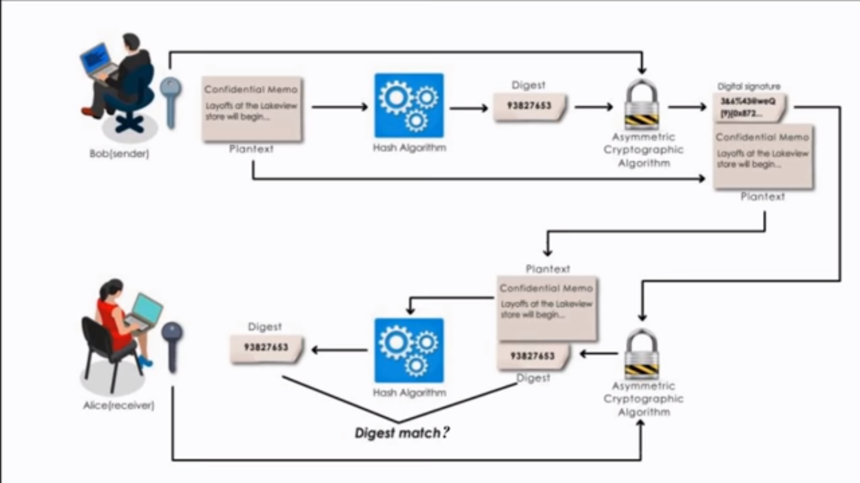

Slide 5

Why Digital Certificate ?

Slide 6
Due to the lack authentication it is important to have the digital certificate.

